Slide 1


CAPSTONE PROJECT
AI-Based Job Market Trend Analysis & Skill Recommendation System
Presented By
Student Name: SOMANA PRAVEEN KUMAR
College Name: chebrolu engineering college
Department: b.tech – data science
Email ID: praveensomana2004@gmail.com

Slide 2
OUTLINE:
Problem Statement (Should not include solution)
Proposed System/Solution
System Development Approach (Technology Used)
Algorithm & Deployment
Result (Output Image)
Conclusion
Future Scope
References

Slide 3
Problem Statement:
In today’s rapidly evolving job market, students and job seekers face difficulty in identifying the most in-demand skills and trending job roles. Due to the vast availability of job postings across multiple platforms, manually analyzing job market trends is time-consuming and inefficient. There is no intelligent system that provides real-time insights into trending skills and personalized recommendations based on actual job market data. As a result, many students learn outdated or irrelevant skills, which affects their employability and career growth.

Slide 4
Proposed Solution:
The proposed system aims to develop an AI-based Job Market Trend Analysis and Skill Recommendation System that analyzes real-time job market data using Natural Language Processing (NLP) and Machine Learning (ML) techniques.
Key Features:
Collect job postings dataset from online job platforms.
Perform data preprocessing and NLP-based skill extraction.
Analyze job descriptions to identify trending skills.
Recommend personalized skills based on selected job roles.
Provide real-time skill suggestions through a web-based interface.
This system helps students, job seekers, and career counselors make data-driven career decisions.

Slide 5
System Approach:
System Requirements:
Hardware:
  Processor: Intel i3 or higher
  RAM: 4GB minimum
  Storage: 20GB free space
Software:
  Python
  Flask Framework
  VS Code
  Google Colab
  Web Browser
Libraries Used:
pandas
scikit-learn
nltk
flask
matplotlib

Slide 6
Algorithm & Deployment:
Algorithm Selection:
The system uses Natural Language Processing (NLP) techniques for text processing and frequency-based learning models for identifying trending skills. Machine Learning techniques are applied to recommend relevant skills for each job role.
Data Input:
Job Title
Job Description
Industry
Location
Training Process:
Data cleaning and preprocessing
Tokenization and text normalization
Stopword removal
Skill keyword extraction
Frequency-based pattern learning

Slide 7
Prediction Process:
User inputs job role
System analyzes similar job descriptions
Extracts frequent skills
Displays top recommended skills
Deployment:
The system is deployed using Flask web framework as a local web application, allowing users to interact via a browser interface.
SYSTEM ARCHITECTURE
User Input → Web Interface → Flask Server → NLP Processing → Skill Extraction → AI Recommendation Engine → Output Display

Slide 8
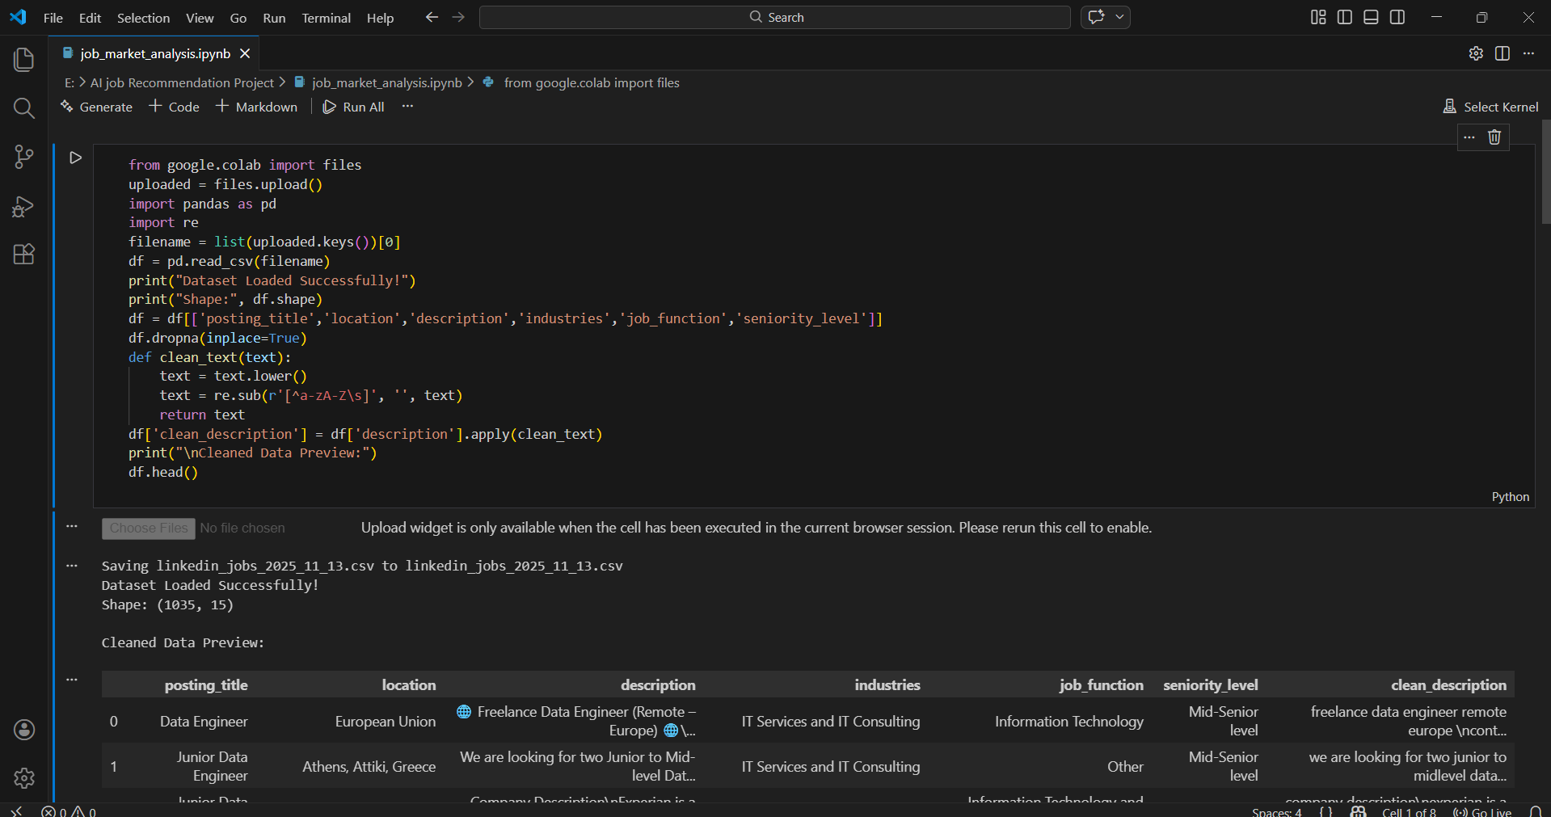
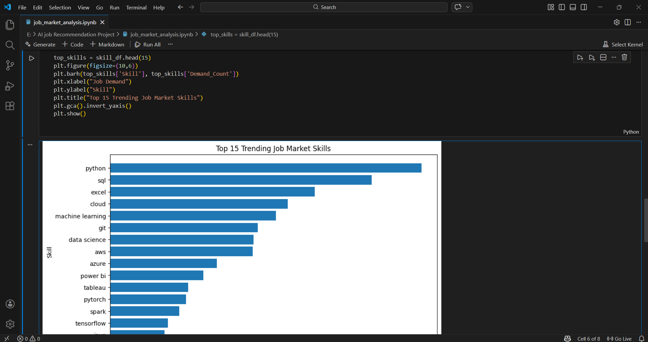
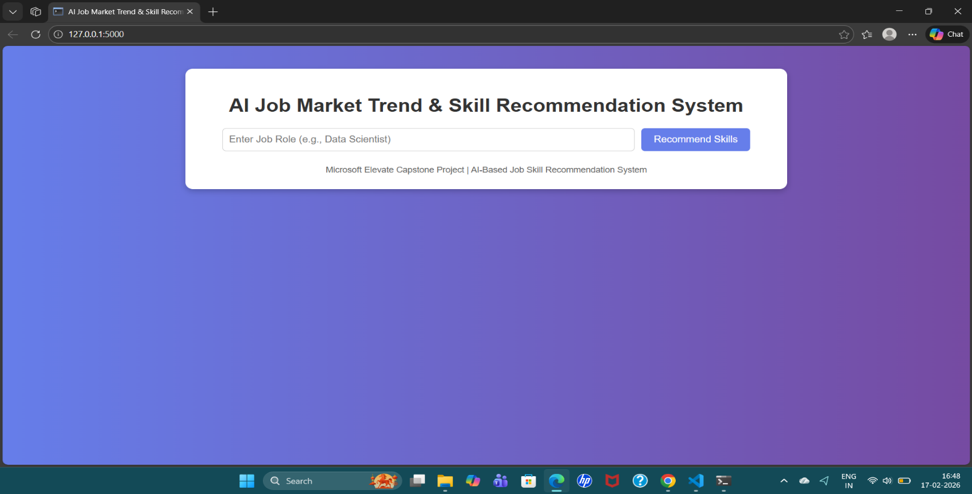
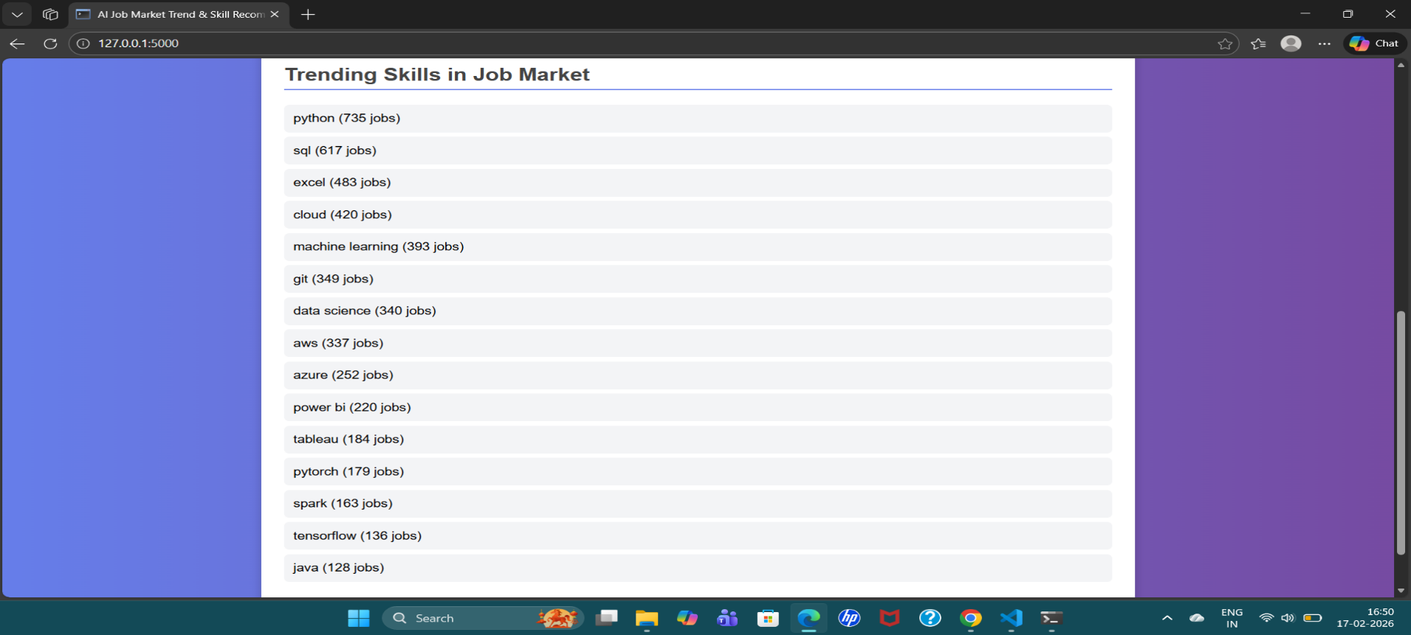
Result:

Slide 9
Conclusion:
The AI-Based Job Market Trend Analysis & Skill Recommendation System effectively analyzes real job market data and provides intelligent career guidance. By leveraging NLP and ML techniques, the system delivers accurate insights into trending skills and helps students and job seekers make informed career decisions. This project demonstrates the practical application of Artificial Intelligence in solving real-world problems and contributes positively to career development.

Slide 10
Future scope:
Integration with live job APIs (LinkedIn, Indeed, Naukri)
Advanced AI models such as Deep Learning (BERT, LSTM)
Career path prediction
Resume analysis and job matching
Cloud deployment with public access

Slide 11
References:
List and cite relevant sources, research papers, and articles that were instrumental in developing the proposed solution. This could include academic papers on bike demand prediction, machine learning algorithms, and best practices in data preprocessing and model evaluation.
GitHub Link: Link

Slide 12
Thank You

